Slide 1
All-Wales Intensive Learning Academy for Innovation in Health and Social Care (IHSC)
PESTEL Analysis
CPR Global Tech ltd

Slide 2
Technological innovation
Technology-Innovation refers to the process of creating new and improved technologies that disrupt markets, challenge organizational capabilities, and lead to significant advancements in organizational performance.
Advantages | Disadvantages
Opportunities for Entrepreneurs | Uncertainty and Risk - financial risks for both incumbents and new entrants.
Market Disruption | Obsolescence of Existing Knowledge - existing skills and knowhow may become obsolete.
Adaptive Capacity - enhancing their long-term sustainability. | Resource Allocation - struggle to balance resources
Informed Decision-Making - make better strategic decisions regarding investments in innovation. | Cultural Resistance - encounter internal resistance to change, to adapt to change.
Smelser, N.J. and Baltes, P.B. (2001). International Encyclopedia of the Social & Behavioral Sciences . [online] Amsterdam: Elsevier, Pergamon. Available at: https://www.sciencedirect.com/referencework/9780080430768/international-encyclopedia-of-the-social-and-behavioral-sciences#book-info.

Slide 3
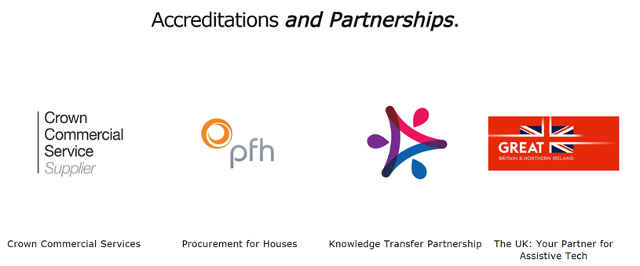
CPR Global Tech Ltd

Slide 4
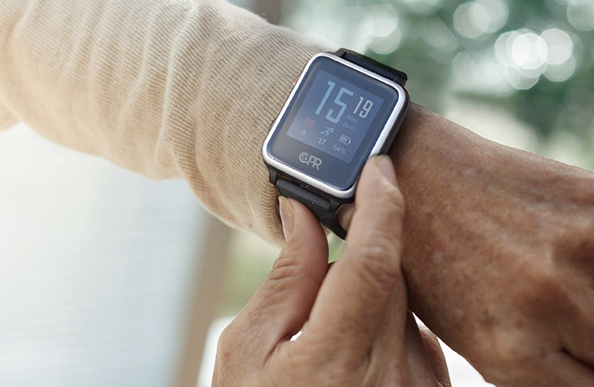
Products
Call Blocker Range
Pre-programmed to automatically block thousands of known spam numbers, they also make it simple and satisfying to block new problem numbers: simply push the big red button.
WATCHU Guardian Kids
WATCHU Guardian Kids is a wearable phone and locator that combines an emergency assist function, voice calling and location tracking into one simple watch.
CPR Guardian 3 Personal Alarm
The CPR Guardian has been designed to protect the wearer and summon emergency assistance when they need it. The SOS button makes it simple, speedy and discreet to call for help and tell people where you are.

Slide 5
PESTEL ANALYSIS
The PESTEL framework categorises environmental influences into six main types:
Thus, PESTEL provides a comprehensive list of external influences on the possible success or failure of particular strategies.
It is important to recall that in reality these are all interlinked to some degree.
This framework is used to analyse the macro–environment of organisations.
Political
Economic
Social
Technological
Ecological
Legal
PESTEL analysis is a tool that can identify factors that can affect the organization and then find a way to overcome these factors (Melanie Allen, 2001)

Slide 6
PESTEL ANALYSIS
P Political Factors | E Economic Factors | S Social / sociocultural Factors | T Technological Factors | E Environmental / Ecological Factors | L Legal Factors
Political Stability | Exchange Rates | Age Distribution | Level of Innovation | Climate (changed) | Antitrust Laws
Corruption | Interest Rates | Career Attitudes | Automation | Environmental Policies | Consumer protection Laws
Foreign Trade | Inflation Rates | Safety Emphasis | Electrification | Climate Change | Copywrite and Patent Laws
Tax Policy | Disposable Income | Health Consciousness | Connectivity (e.g. 5G) | Pressures from NGOs | Health and Safety laws
Government Policy | Economic Growth | Population growth/population size | Technology Incentives | Weather (e.g. disaster floods) | Discrimination Laws
Trade Restrictions | Unemployment Rate | Lifestyle | R&D Activity |  | Employment Laws

Slide 7
All-Wales Intensive Learning Academy for Innovation in Health and Social Care (IHSC)
PESTEL Analysis
An Interview with Cheslea Davies
COO, CPR Global Tech ltd

Slide 8
Factors Affecting CPR
Political Factors | Economic Factors | Social / sociocultural Factors | Technological Factors | Environmental / Ecological Factors | Legal Factors
Government stability/instability | Interest rate (Use different payment options) | Population size and growth rate | R&D activity | Environmental policies | Consumer protection laws
Tax policies | Exchange rate (Changes on daily basis) | Age distribution | Connectivity (e.g. 5G) | Natural disasters | Data protection laws
Government involvement in trade unions and agreements | Price fluctuations |  | Technological awareness | Recycling standards

